Slide 1





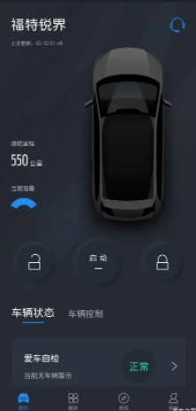
ECG
z
Legend:
Drive Video Record
Feature Scope
Integrated Dash Camera Module (IDCM)
In Vehicle
Out Vehicle
Vehicle Battery
Ethernet/CAN
In IDCM
Wi-Fi
Power Manager
LVDS
Serializer
Live View
Replay
AR Video
CAN
Customer
APIM
Environment
LVDS Coax
Power Input
LVDS
FPD-Link
COAX
Video
Power
I2C
UART
Setting Control
Video Control
Status Sync
Control ACK
Setting Control
Video Display Control
Windshield
Video/Photo display
IDC & AR
Camera
Video Input
TF Card
Manager
Data Copy via TF card
SWDL
eMMC
Customer
Exterior
Environment
G-Sensor
Crash Detect
Setting Control
Video Control
SWDL
Ford APP
Wi-Fi
Manager
Setting Control
Video Display Control
Setting ACK
Control ACK
Data Copy
Video/Photo display

